Slide 1

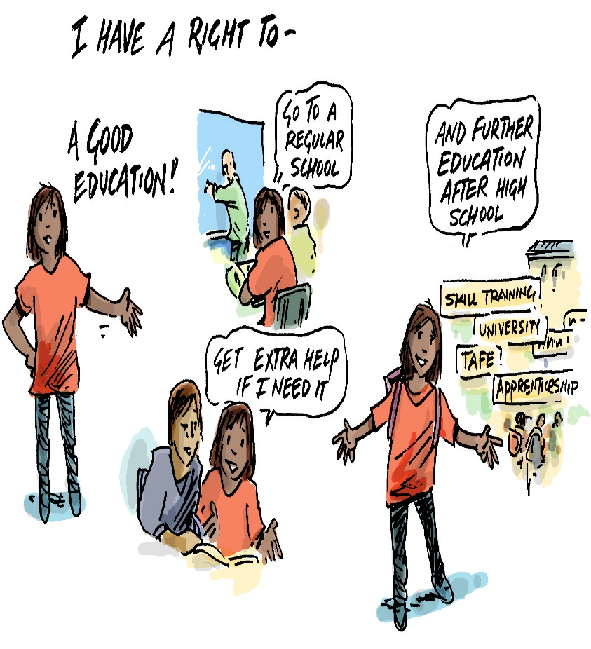

Using the Human Rights Act to
Protect the Rights of Students with Disabilities in QLD
Online workshop for parents
Presented by ~ Emma Phillips & Nikki Parker (QAI)
Notes:
Welcome to CRU’s Families for Inclusive Education online workshop on all things related to, ‘Heading to High School’.
The aim of this interactive online learning session is to assist parents and family members of students with disability to keep on the inclusive path as their child enters the high school years.
Today we will share tips on selecting a high school for your child, how best to approach prospective schools and how to communicate your intention for your child to be included. We will ask you to share your thoughts and concerns via a ‘chat’ session at the start and in ‘break-out rooms’ and Q&A towards the end.
Please share your questions, thoughts and ideas as we go along via the ‘chat’ box.
We will keep an eye on the chat box and do our best to address these messages as we go. We invite you to follow-up with an email or a call any questions we can’t answer today or think may be better addressed in a one-one phone consultation. We will provide these contact details later in the session.
Lindie Brengman and myself are consultants with the FFIE team. We are both parents of children with disability. Both of us have daughters with disability at regular high schools, both girls are currently in Year 10. So, we know high school quite well now. I also have a son, Will who is 12 years of age. He is Autistic and has complex communication issues. Will is to transition to Year 7 in 2021.

Slide 2


Who is CRU?
CRU exists to support the development
of leadership and authentic change which enhances the possibilities for people with disabilities to belong to and participate in community life.
It aims to:
Challenge ideas and practices which limit the lives of people with disabilities and;
Inspire and encourage individuals and organisations to pursue better lives for people with disabilities.
Notes:
Lindie and I are aware that some joining us today may not have connected with CRU before. CRU or The Community Resource Unit has been around for over 30 years. CRU strives to inspire and encourage individuals and organisations to pursue better lives for people with disability.

Slide 3
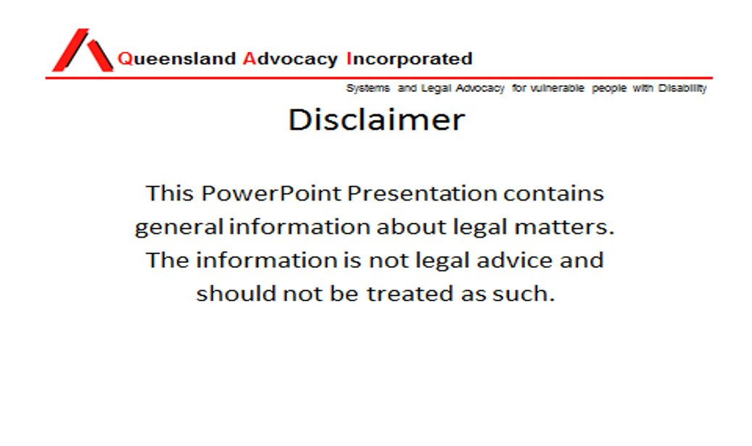

Slide 4
Content of this workshop
Human rights protections in Queensland and the right to education
Avenues of complaint for human rights breaches and discrimination (including costs and risks)
Other available avenues for resolution of issues with a school
Options to achieve systemic change and improvement
Resources
Questions

Slide 5
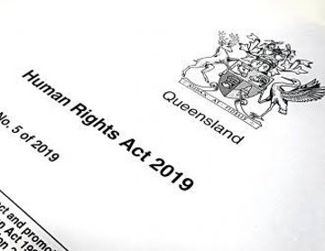
Human rights protection in Queensland and avenues of complaint

Slide 6
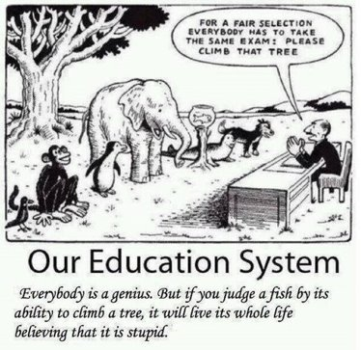
Laws to protect children with disabilities in the Queensland education system
Human Rights Act 2019 (Qld)
Anti-Discrimination Act 1991 (Qld)​
Disability Discrimination Act 1992 (Cth)​
Education (General Provisions) Act 2006 (Qld)
Disability Standards for Education (Cth)

Slide 7
Human Rights Act 2019 (Qld) (‘HRA’)
It protects human rights → the basic rights that belong to every person, regardless of age, race, sex, social status or other characteristic​
Protects the human rights of all people in Queensland​
Binds “public entities” → core and functional​
Dialogue model – human rights are taken into account across the three arms of government​
Accessible complaints mechanism​
Protects a range of human rights that Australia has agreed to protect at international law​
Most human rights are individual, some belong to groups (eg cultural rights)

Slide 8
Rights protected by the HRA
Civil and political rights​
Recognition and equality before the law​ | Right to life​
Protection from torture and cruel, inhuman or degrading treatment​ | Freedom from forced work​
Freedom of movement​ | Freedom of thought, conscience, religion and belief​
Freedom of expression​ | Peaceful assembly and freedom of association​
Taking part in public life​ | Property rights​
Privacy and reputation​ | Protection of families and children​
Cultural rights – generally​ | Right to liberty and security of person​
Humane treatment when deprived of liberty​ ​ | Fair hearing​ ​
Rights in criminal proceedings​ ​ | Children in the criminal process​ ​
Right not to be tried or punished more than once​ ​ | Retrospective criminal laws​ ​
Cultural rights of Aboriginal and Torres Strait Islander peoples​ ​ | ​
Economic, social and cultural rights​
Right to education​ | Right to health services​

Slide 9
The right to education
Every child has the right to have access to primary and secondary education appropriate to the child’s needs.​
Every person has the right to have access, based on the person’s abilities, to further vocational education and training that is equally accessible to all.

Slide 10
The origins of the right to education in international & domestic law
Council of Australian Government’s National Disability Strategy (2011)​
Australian Curriculum​
Australian Professional Standards for Teachers​
National Quality Framework​
Early Years Learning Framework for Australia​
Queensland Department of Education Inclusive Education Policy 2020
Article 13 of the International Covenant on Economic, Social and Cultural Rights (ICESCR)​
Article 28 of the Convention on the Rights of the Child (CRC)​
Article 24 of the Convention on the Rights of Persons with Disabilities (CRPD)​
World Declaration on Education for All​
UN Standard Rules on Equalization of Opportunities for Persons with Disabilities​
Salamanca Declaration and Framework for Action​

Slide 11
Obligations of public entities
To make decisions compatible with human rights​
To give proper consideration to relevant human rights in making decisions, which includes:​
  Identifying the human rights that may be affected by the decision; and​
  Considering whether the decision would be compatible with human rights.​
Certain Children v Minister for Families and Children & Ors [2016] VSC 796​
Minister for Families and Children v Certain Children [2016] VSCA 343​
Certain Children v Minister for Families and Children (No 2) [2017] VSC 251

Slide 12
Limits to human rights
The HRA allows for reasonable limits to be placed on human rights, which may be justified in a “free and democratic society based on human dignity, equality and freedom”.​
“Proportionality test” used to determine whether limitation is reasonable and justifiable. This test considers: ​
  nature of human right;​
  purpose of limitation;​
  relationship between limitation and purpose; ​
  whether there are less restrictive and reasonably available options;​
  importance of purpose of limitation; and​
  importance of safeguarding the human right.​
HRA permits decisions and actions that are not compatible with human rights if the decision maker ‘could not reasonably have acted differently or made a different decision’ because of that other law (s58(2)).

Slide 13
Complaints mechanisms
Raise issue directly with public entity​ (not required for discrimination complaints)
Lodge a written complaint with QHRC (after 45 days) - 12 month timeframe (discrimination complaints can be lodged with QHRC or AHRC)
Conciliation of complaint if accepted​
Additional options
Option for referral of discrimination complaints (and note s 75 HRA)
Option to include human rights complaint as part of court action to protect another legal right​

Slide 14
Costs and risks of taking legal action
No cost to lodge complaint with QHRC – costs (financial and other) involved in legal advice
Risk that complaint will not be accepted by QHRC
Risk that complaint will not be resolved in conciliation and require further litigation
Collateral – breakdown of relationship with school

Slide 15
Avenues for resolution of issues with a school and options to achieve systemic change

Slide 16
Available avenues for resolution
Support network and support groups – e.g. QCIE, Carers Qld
CRU: Families for Inclusive Education, resources,
Raise issues with school Principal and request action
Engage with regional office
Department of Education complaints process
  Can lead to human rights/discrimination complaint

Slide 17
Department of Education complaints process
https://qed.qld.gov.au/contact/customer-compliments-complaints
Can use the complaints process to attempt to resolve issues
Submitting a complaint (and asking that it be treated as a human rights complaint) is the first step for a complaint to the QHRC
Complaint to:
  principal if about school staff member
  regional office if about principal

Slide 18
Department of Education complaints process
Written complaint
Response
If not satisfied with the response:
  QHRC complaint
  Internal review (within Department of Education)
If not satisfied with internal review response, external options include QCAT or Office of the Queensland Ombudsman

Slide 19
Complaint to Department of Education
State issues clearly and succinctly
If you are able, refer to:
  Disability Standards for Education
  Departmental policies and procedures
  Human Rights Act
Include evidence of complaint
Resolutions sought
Request that it be treated as a human rights complaint, and as a complaint under the complaints framework

Slide 20
Systemic change and improvement
Power of community to create change through networks of individuals and groups
Australian Coalition for Inclusive Education
QAI – systems advocacy
Queensland Collective for Inclusive Education
Engagement with the Disability Royal Commission

Slide 21
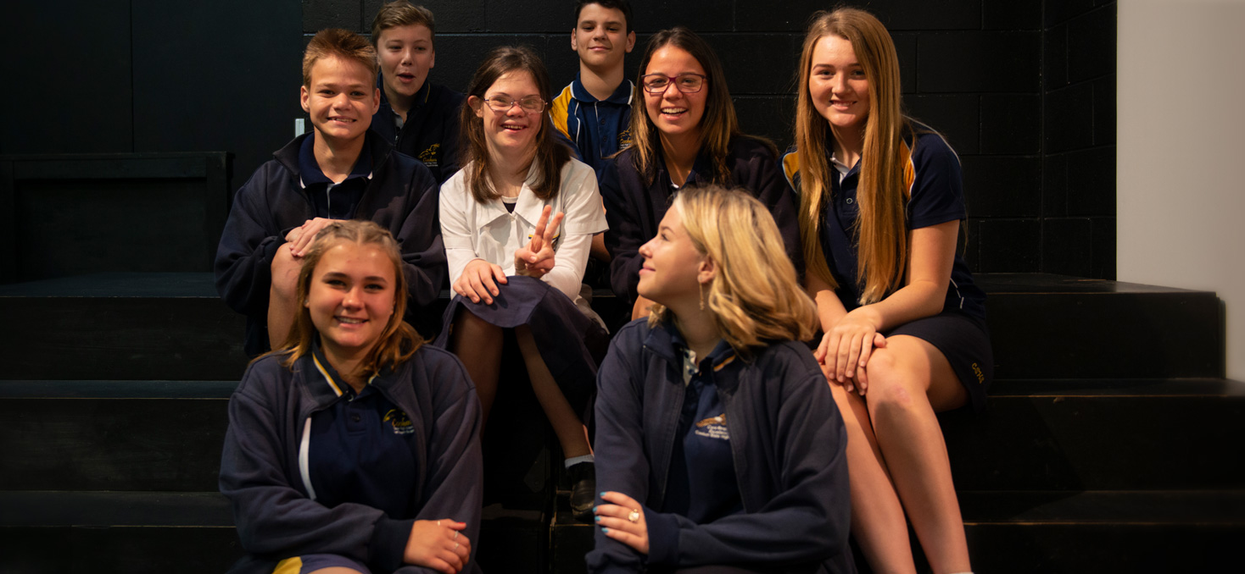

Scenario – failure to implement reasonable adjustments

Slide 22
Resources
Queensland human rights case notes:
  https://law.uq.edu.au/research/human-rights/case-notes
QHRC:
  https://www.qhrc.qld.gov.au/your-rights/human-rights-law/right-to-education
  https://www.qhrc.qld.gov.au/your-rights/discrimination-law/discrimination-in-education
QAI:
  Human Rights Legal Service
  Education Advocacy Service

Slide 23
Resources (continued)
CRU:
  Families for Inclusive Education Project
QCIE:
  Peer support Facebook group
Caxton Legal Centre:
  https://caxton.org.au/unlocking-the-human-rights-act-2019-for-your-clients-the-right-to-education/

Slide 24

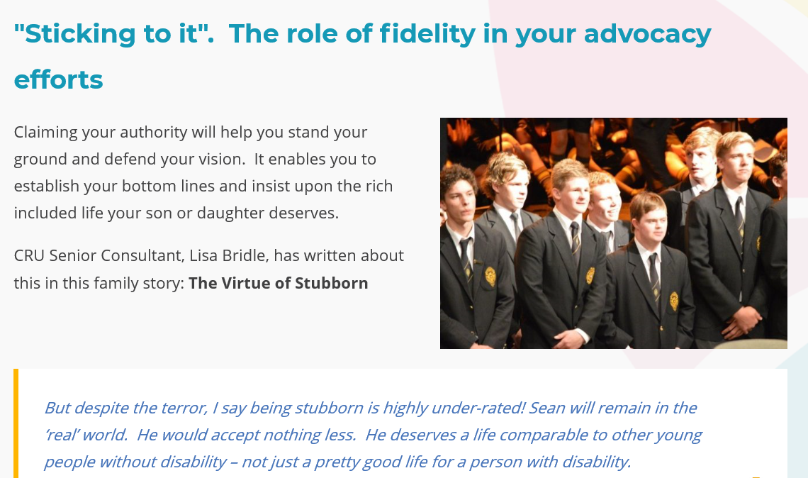

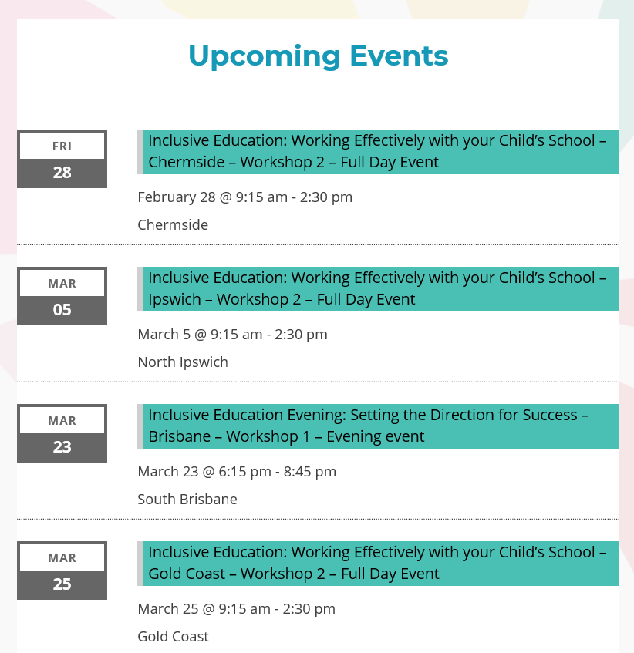
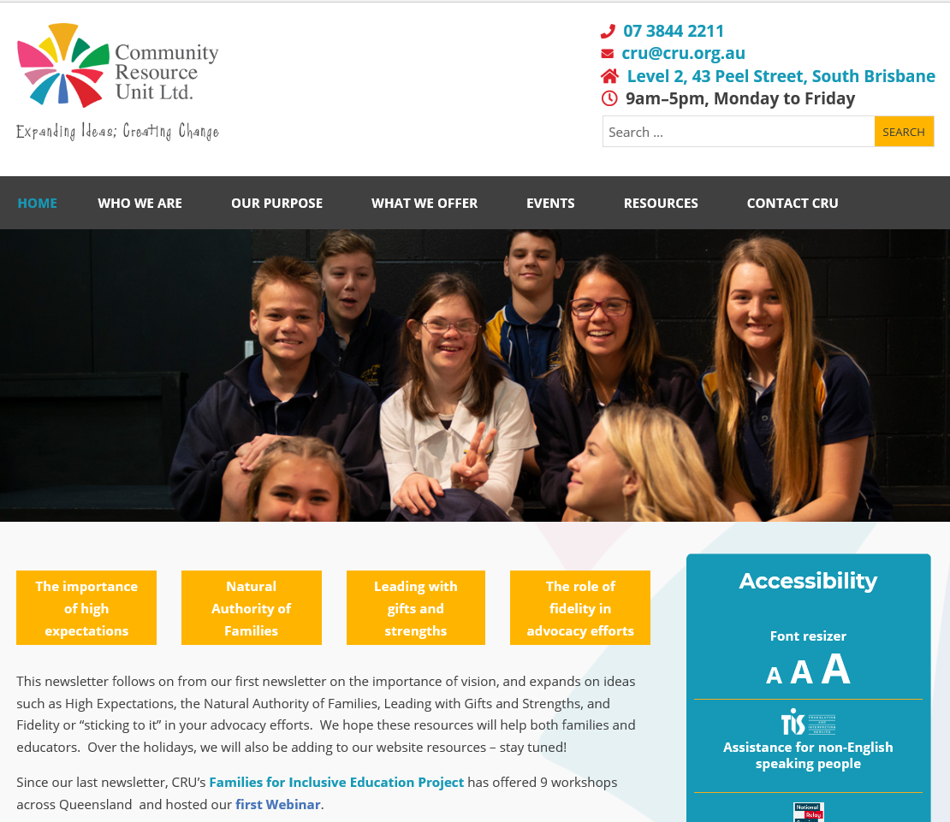
Families for Inclusive Education Resources
Resources:
Families for Inclusive Education ~ CRU website
Activities:
Workshops, Resource Development, Individual Consultations, Webinars, Peer Support Development
Stand Strong –
our schools and communities
are better when everyone belongs
Notes:
CRU now has many, many helpful resources available for free! I Choose Inclusion, More than academics & Building Belonging in particular!
Keep an eye out for our follow-up email we will include links to resources etc… that we mentioned today in our email.
Don’t forget individual consultation service and to keep an eye out for other upcoming CRU and FFIE events.

Slide 25


Families for Inclusive Education
Using the Human Rights Act to
Protect the Rights of Students with Disabilities in QLD
All rights reserved. CRU - Community Resource Unit Ltd. © Copyright 2020
ABN: 16 143 460 250 | ACN: 617 860 009
Notes:
Thank you for joining us today an

Slide 26

Questions

